Slide 1

MEET THE TEACHER
September 2026
Year 1

Slide 2
Welcome …
Senior Leadership Team
Brindishe Federation and Brindishe Lee priorities
Attendance & Punctuality
Communication Channels
Arbor and paying money
Nourish – school meals and FSM
Key Dates
Website
Statutory Testing (if applicable)
Year Group Team
Meet the Teachers and TAs
Yearly Overview for 2026/2027
Autumn Term Overview
PE expectations and dates
Enrichment Opportunities, including planned trips and visits
How parents/carers can support at home
Home Learning
Opportunity for any questions from parents/carers

Slide 3


Brindishe Federation Priorities 26/27

Slide 4
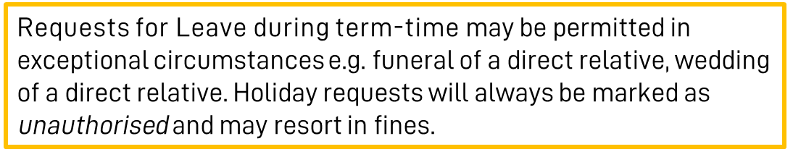
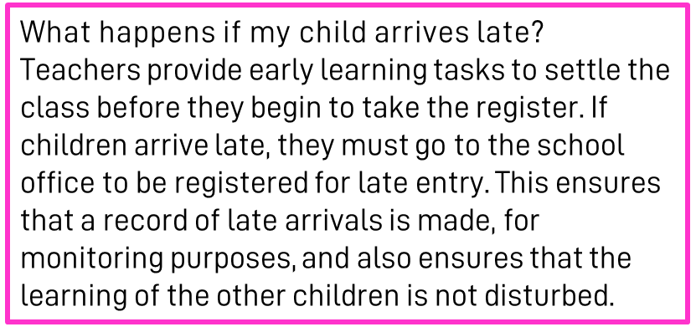
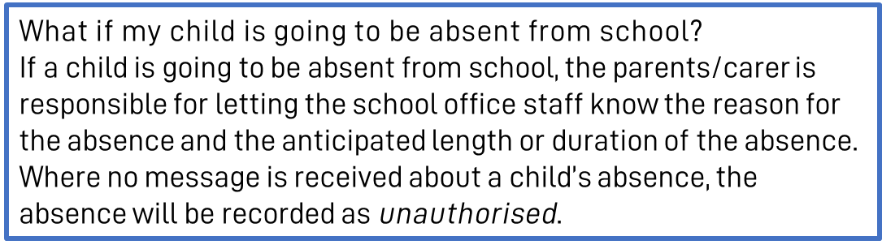
Attendance & Punctuality
At Brindishe Schools we believe that good attendance and punctuality are essential. Research shows that children who attend school regularly do better at school and make better progress.
Brindishe Lee
Start Time - Gates Open 8.50am/Gates Close 9.00am
Children are expected to be in school by 9am. Children arriving after 9am will be marked at ‘late’
Finish Time - School Ends 3.30pm.

Slide 5
Attendance & Punctuality
Planned Absences
Please ensure that you inform the office of any planned absences in advance, either by email or telephone e.g. Eid, Secondary School visits/tests.
Last Minute Collection Arrangements
Please telephone the school office before 2pm if collection arrangements for your child have changed for that day.
Pick-Up Passwords
If another adult is collecting your child, they will be required to provide a ‘pick-up’ password before they can take your child home. Please ensure you pass this onto the school office when you inform them of alternative collection arrangements.

Slide 6
Communication Channels
Absent Reporting
To report your child absent please call or email before 8.30am. Please call the school on each day of your child’s absence.
Brindishe Lee - 0208 318 4626- info-BL@brindisheschools.org
Message for Class Teacher or a member of the Senior Leadership Team
Email info-BL@brindisheschools.org – please mark ‘For Attention Of …’ followed by the name of the member of staff e.g. FAO Mrs Bannister.
Extended Services –Sportacus
Sportacus can be contacted at Info@Sportacus.co.uk Telephone on: 0789 793 2884
General Enquiries
0208 318 4626– info-BL@brindisheschools.org
Our preferred method of communication is via email if you cannot find the answer on the school website. Emails will be responded to within 48 hours so if it is an emergency, please call the school directly.
Nourish and School Meals
Clare Doran - schoolmeals@brindisheschools.org
M: 07943 041790

Slide 7


Arbor
What can you do on the Arbor App?
Add and amend information
See school notices
Update child’s information
Update your information
See your child’s lessons
See your child’s attendance
Retrieve an attendance summary for week, term and/or the year
Book a parent/carer consultation
Sign your child up for clubs, trip, visitors and music
Pay for trips and clubs (where needed)
See account balances

Slide 8

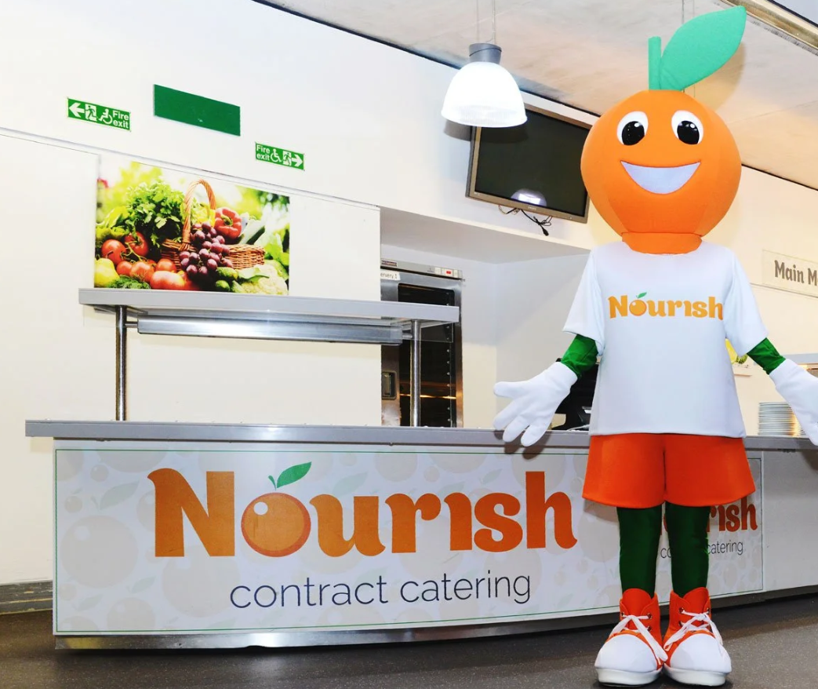
Nourish (school meals) and FSM
Nourish is a friendly family-led school caterer with bags of initiative and a love of good food. They believe every child needs a satisfying meal at lunchtime, fuelling them for the afternoon ahead. Nurturing the importance of a healthy and balanced diet, they provide a nutritious meal every day to nourish from within.
Each day the children will have a choice of:
Three main dishes
A pudding OR a choice of either cheese/biscuits or yoghurt
Freshly baked bread
Fresh fruit
Nine salad choices each day from the salad bar
Milk and water
Cost per day: Free under the current Mayor of London’s Scheme
Autumn Term Menus can be found on the school website.

Slide 9
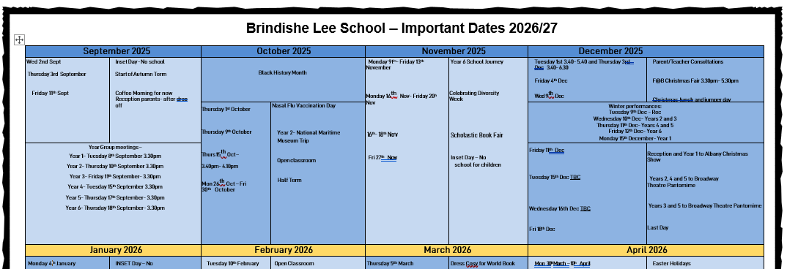
Key Dates
Term Dates: 2026–2027
Autumn Term
Thursday 3rd September 2026 to Friday 23 October 2026
Half-term: Monday 26 October 2026 to Friday 30 October 2026
Monday 2 November 2026 to Friday 18 December 2026
Spring Term
Tuesday 5 January 2027 to Friday 12 February 2027
Half-term: Monday 15 February 2027 to Friday 19 February 2027
Monday 22 February 2027 to Wednesday 24 March 2027
Summer Term
Monday 12 April 2027 to Friday 28 May 2027
(the early May bank holiday will be taken on 3 May)
Half-term: Monday 31 May 2027 to Friday 4 June 2027
Monday 7 June 2027 to Wednesday 21 July 2027
INSET DAYS
Wednesday 2 September 2026
Friday 27 November 2026
Monday 4 January 2027
Thursday 25 March 2027
Thursday 22 July 2027
We will endeavour as much as practically reasonable, to provide you with dates well in advance. Please see our ‘Key Dates for Parents/Carers’ document on Weduc. Class teachers will give you at least 2 weeks' notice of a planned Educational Visit.

Slide 10
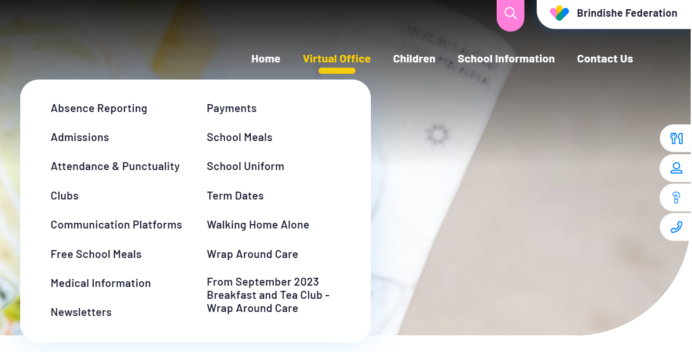
Website
The Brindishe Federation and school website provides all key information needed for parents/carers.
The website includes:
School Policies, including Attendance, Admissions, Complaints and RSHE
Meet our Governing Body
Nourish Termly Menus
The Brindishe Curriculum and Year Group Overviews
Data and Performance Measures
External Reviews – Ofsted
Typical School Day
How to support your child at home
Clubs and Wrap Around Care
Weekly federation and school newsletters
Reading
Equalities & Diversity
PTAs
….. And much more.
The website also provides a virtual office function – please visit the virtual office for all your daily enquiries and needs.

Slide 11
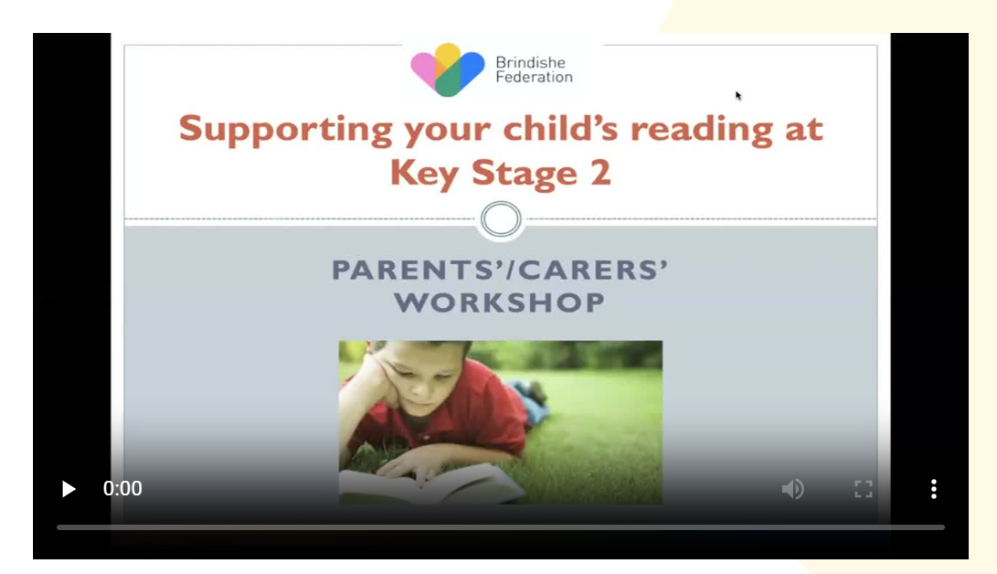
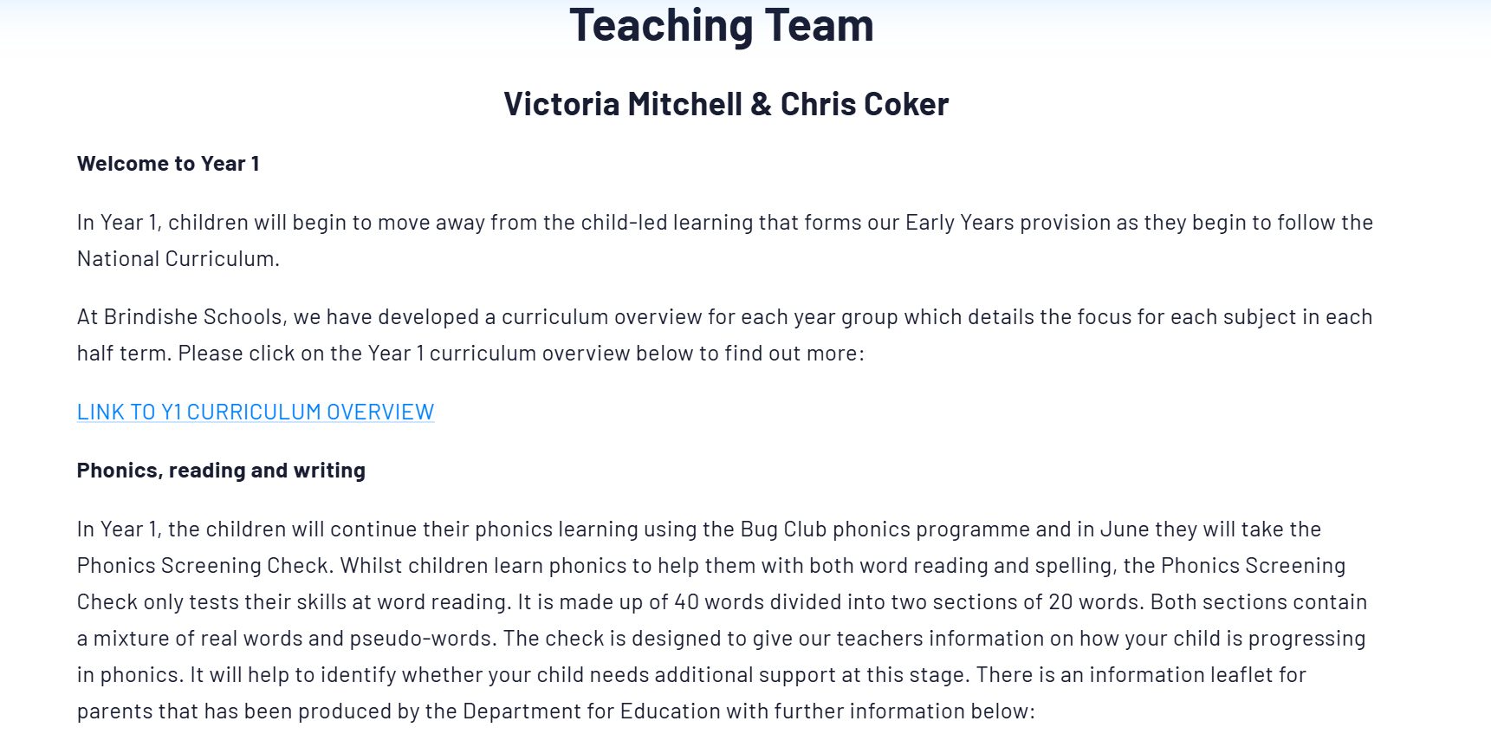
Website – Class Pages
Curriculum Overviews
Videos to support learning
Core Subject Specific Information (Maths and English)
Spelling Lists
Teaching Teams
Newsletters

Slide 12
Year 1 Phonics Screening Check
The Year 1 phonics screening check is not a formal test, but a way for teachers to ensure that children are making sufficient progress with their phonics skills to read words and that they are on track to become fluent readers who can enjoy reading for pleasure and for learning.
It is taken individually by all children in Year 1 in England, and is usually taken in June. It is designed to give teachers and parents/carers information on how your child is progressing in phonics. It will help to identify whether your child needs additional support at this stage so that they do not fall behind in this vital early reading skill.
It checks that your child can:
Sound out and blend graphemes in order to read simple words.
Read phonically decodable one-syllable and two-syllable words, e.g. cat, sand, windmill.
Read a selection of nonsense words which are referred to as pseudo words.
The check is not about passing or failing but checking appropriate progress is being made. If children do not reach the required standard, then the teacher will be in touch to discuss plans and offer additional, tailored support to ensure that your child can catch up. Children progress at different speeds so not reaching the threshold score does not necessarily mean there is a serious problem. Your child will re-sit the check the following summer term.
For the last few years, the threshold mark (or pass standard) set by the government has been 32 correct answers out of 40.

Slide 13
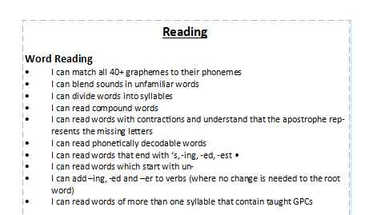

End of Year Expectations
Response and feedback from parent/carer survey indicated a want and need for clearer end of year expectations for your children.
Today, all families will receive the ‘End of Year Expectations’ booklet. We hope this will support you in knowing where how your child is progressing and how to support at home.

Slide 14

How can school and home collaborate and work together?
Join our PTA – Brindishe Friends Group – Over £20,000 raised last year which contributed to the hall acoustics and will fund the OPAL Playground initiative.
Trips and Visitors can be paid for online via Arbor – without your contributions trips and enrichment opportunities cannot go ahead.
We strive to communicate with you as much as possible and in a timely manner. Please remember that communication channels are via info-BL@brindisheschools.org.
Engage with Arbor and the school website as much as possible, especially when paying for clubs, trips and music.

Slide 15
MEET THE YEAR GROUP TEAM

Slide 16
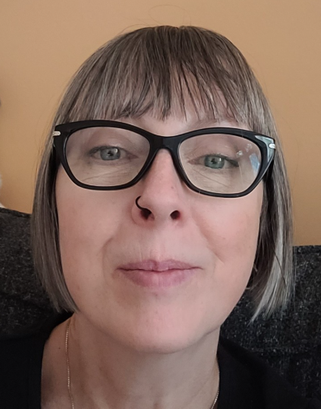
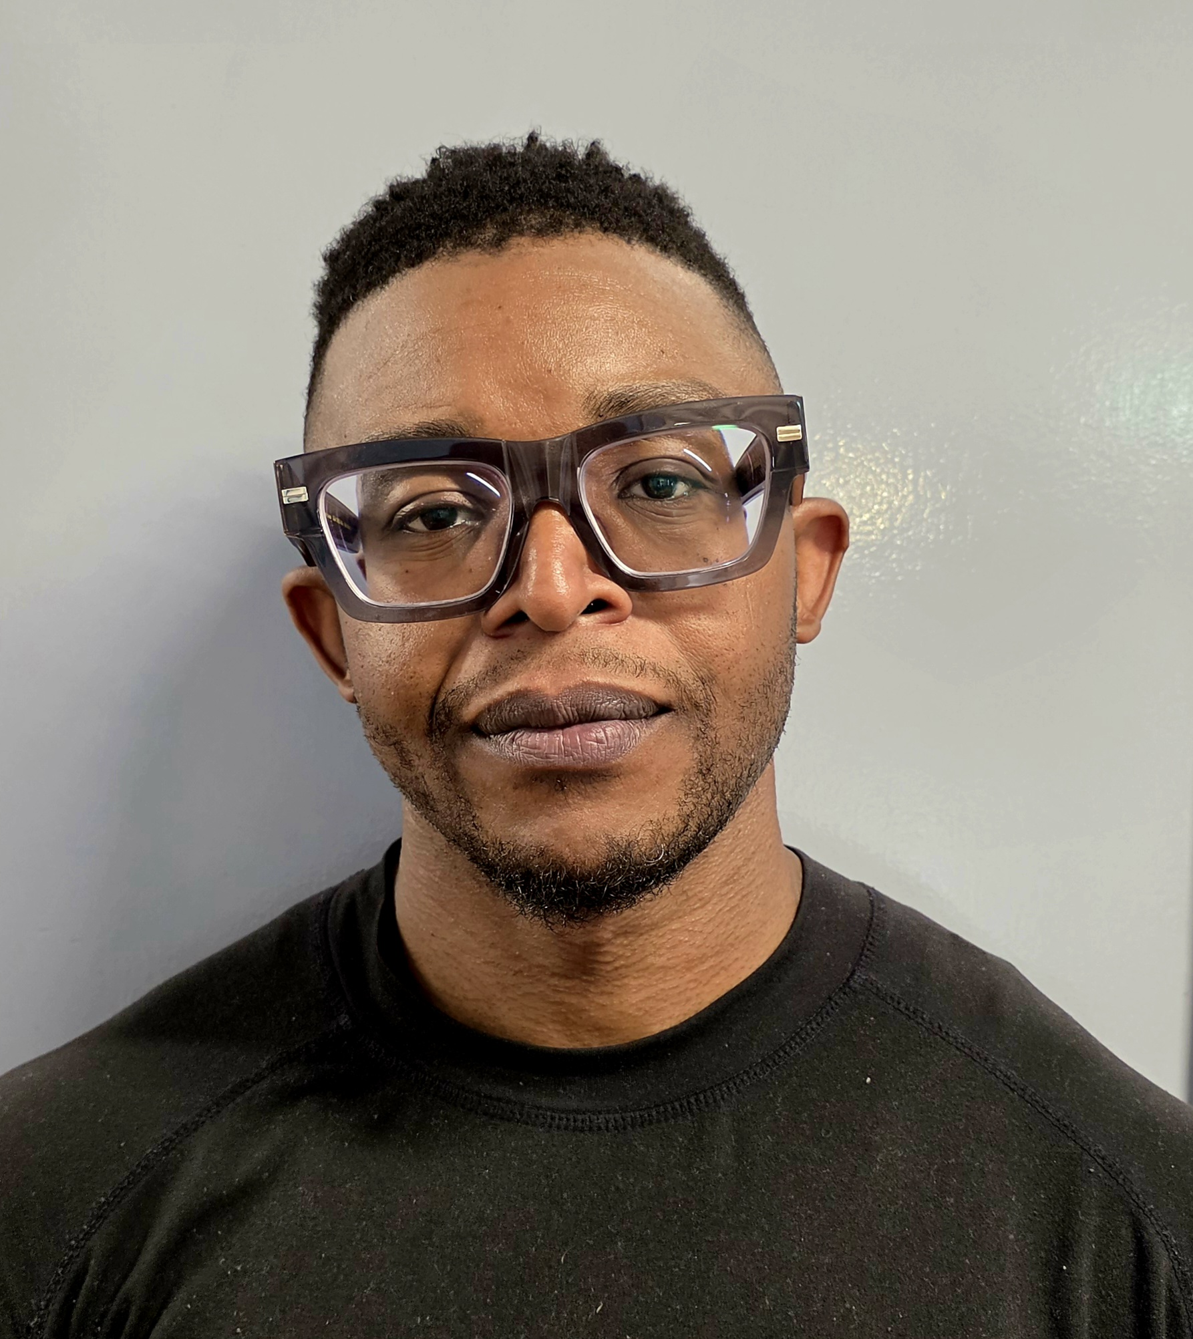
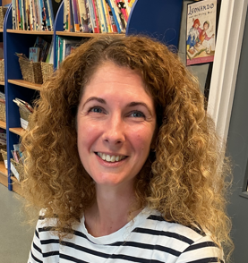
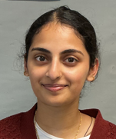
Meet the Team
Teachers:
Ms Mitchell Mr Coker
Teaching Assistants:
Miss Agnes Miss Ajeena

Slide 17
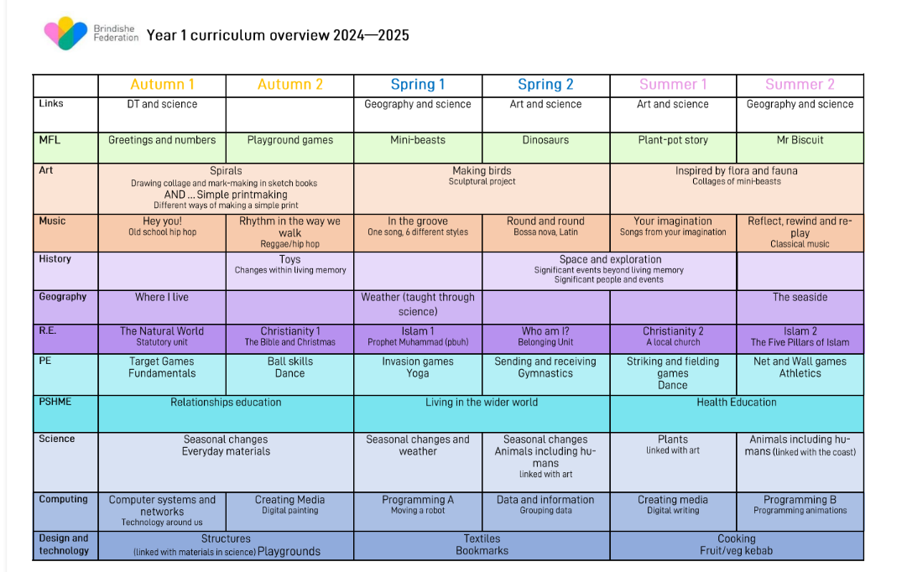
Yearly Overview
Insert Yearly Overview here and give a brief overview of the themes planned during the academic year 2026/2027.
Include key texts that will be studied during each term – where possible.

Slide 18
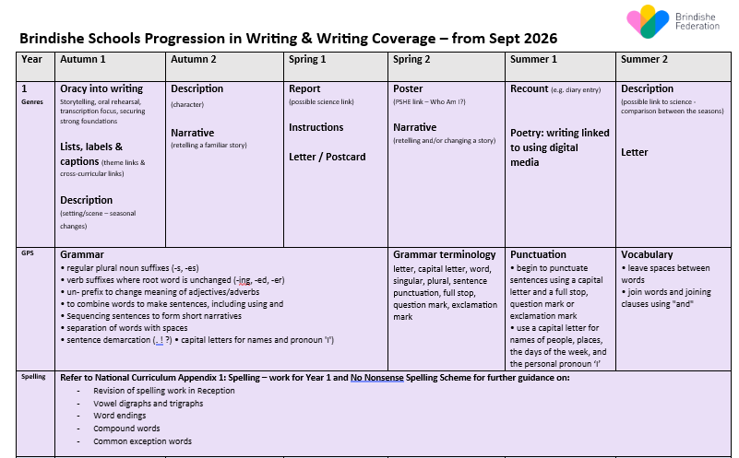
English Yearly Overview

Slide 19
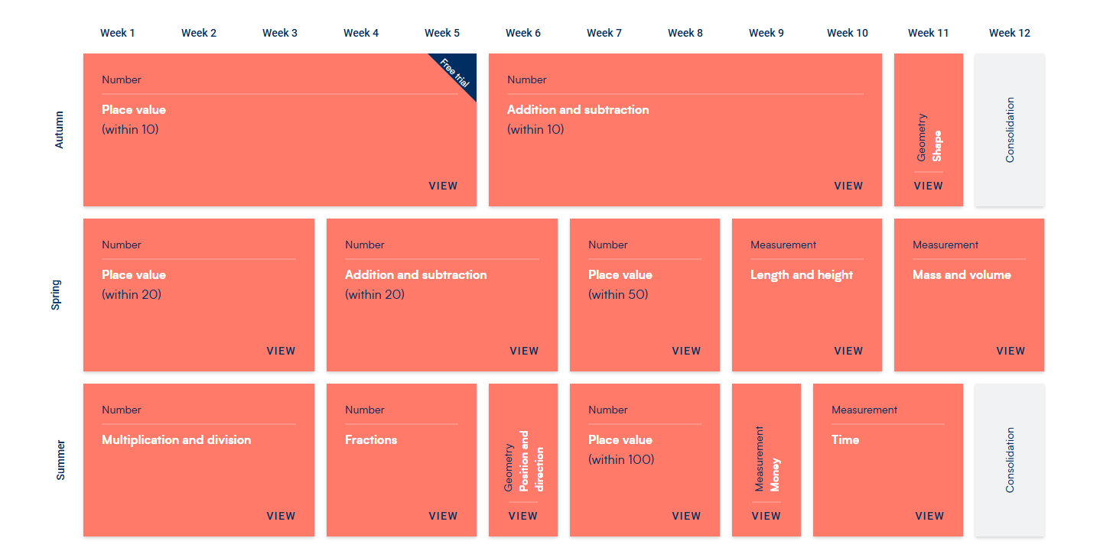
Maths Yearly Overview

Slide 20
Autumn Term Overview
English:
Our focus throughout the year will be on writing simple sentences using capital letters, finger spaces and full stop. We will also work on using our phonics to represent words in a phonetically plausible way. We will begin Autumn by looking at specific skills such a list, label and caption writing as well as poetry. After half term we will be exploring new skills such as character descriptions and re-telling a familiar story.
Maths:
There is a strong focus on Place Value in Year 1, which allows children to become confident with their numbers and number bonds. We will begin Autumn looking at sorting, counting and recognising numbers and this will help us move onto addition and subtraction number bonds within 10.
Science:
In Science, we will be looking at materials and linking this to a DT project towards the end of term. Throughout the year, we have a focus on seasonal changes and explore the different seasons and what changes come with them.
Geography:
Geography in Autumn 1 explores the area that we live in. We will use technology to explore the area around our school whilst noticing human and natural features within our city.
RE:
We will begin RE by looking into ‘The Natural World’ which explores creation stories in Christianity, Islam and Judaism. After half term we will cover Christianity: The Bible and Christmas. This is where we will learn about how Christians believe in their holy book; the Bible and it contains stories about Jesus. We will read stories about what Jesus did in his life and will be learning the story of his birth through performing a nativity.
PSHME:
This term we will look at relationships which delves into families and friendships, what it mean to have safe relationships as well as respecting ourselves and others.
Art
Art will investigate spirals and simple printmaking. We will be completing our artwork in our brand-new sketchbooks!

Slide 21
Planned enrichment opportunities, trips and visits.
Autumn 2 – Visit to Deptford 's Albany Empire – The Gingerbread Man on Friday 11th December
TBC – Horniman Museum for Toys Workshop
Spring 1 – Visit to a local mosque
Spring 2 – Greenwich Observatory
Summer 1 – Gallery Visit
Of course there are a number of after-school clubs and music lessons available throughout the term.

Slide 22
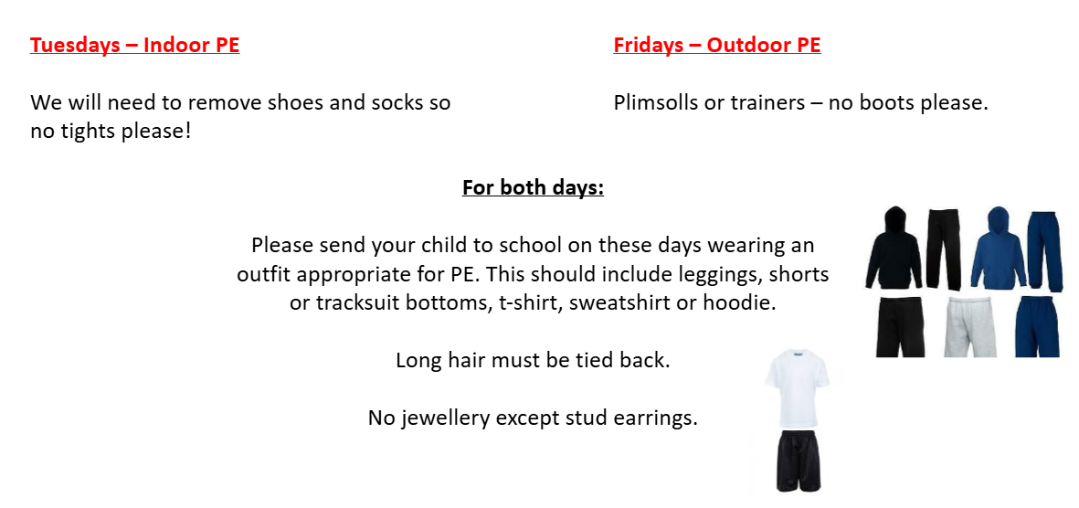
PE Expectations and dates

Slide 23
Home-Learning Expectations
Daily reading:
We will change the children’s reading books every Tuesday and Friday- please ensure that their Reading Diary and book is in their bag on these days. Please read daily at home and write any comments into their Reading Diary. Children can also access extra reading books at their level as well as games on the Bug Club platform.
English/Phonics:
The children will also get English which links to the learning we have done at school. The focus for this may be to recap a skill we have learnt in class or to focus on constructing simple sentences with capital letters, finger spaces and full stops.
We will put the new sounds that were learnt in class each week into their Home Learning books. Please cover these sounds with them at home.
Maths:
Every week, we will give children work which links to the learning they have done during the week at school. Children also have access to SumDog which has a range of activities and games!

Slide 24
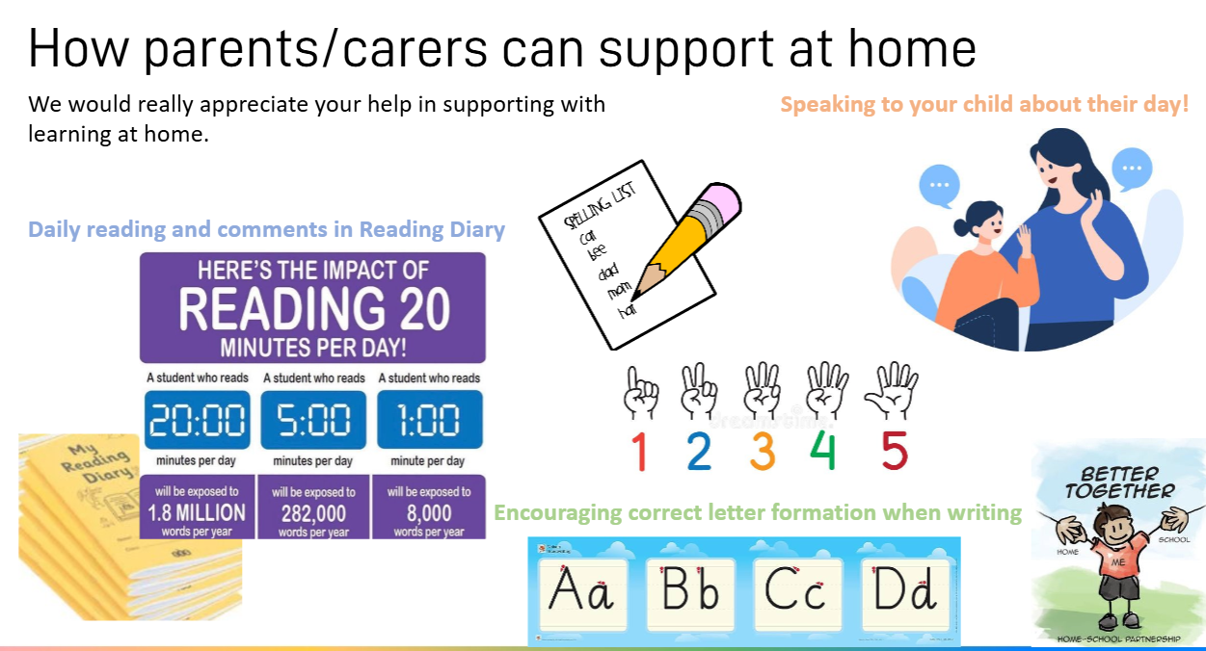
How parents/carers can support at home

Slide 25
How to contact us
Class teachers are always available for brief informal chats on the playground at the end of the day.
For more formal and longer meetings or phone calls, please email info-BL@brindisheschools.org and mark the email ‘For the Attention Of….’ followed by the class teachers name e.g. FAO Ms Mitchell / Mr Coker

Slide 26
Any Questions?

